Slide 1

Road Management System
Ibrahim Abou Zahr – Mohamad Abdel Rahman – Ali Yaman – Yehya Fleifel

Slide 2
Project idea and goals (1)
What is the purpose of our software?
Ensures city hall policies are being enforced via reports from residents.
Establishes a strong connection between the municipality and the community.
Prioritizes safety and cleanliness in the neighborhood.
Fosters cooperation between district managers and locals to address street related issues.

Slide 3
Project idea and goals (2)
What are the problems being tackled?
Common problems of street ignorance, notably sinkholes acting as accident risks.
Thrown garbage on sidewalks causing environmental health problems.
Broken street lights which is a dangerous hazard requiring immediate reporting.
Lack of manhole covers due to theft and vandalism.

Slide 4
Project idea and goals (3)
What is our software hoping to solve?
To create a save environment for drivers on roads.
To solve the garbage problem on sidewalks.
Ensure that streets at light are more secure and visually visible.
Build a community that looks to improve their city’s maintenance.
Making a secure system for all users.

Slide 5
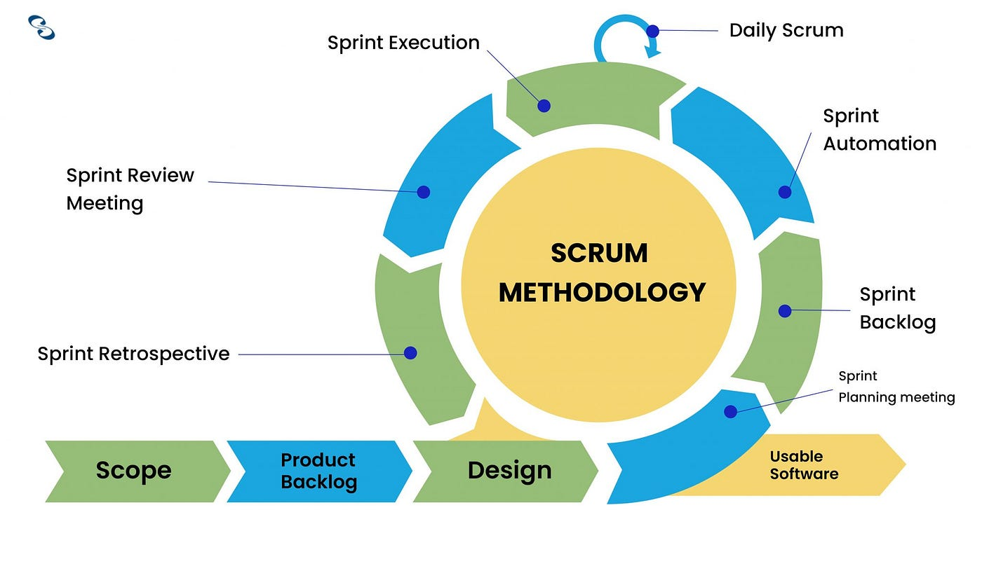
Sdlc Model Used
Why use scrum?
Flexible and adaptive
Continuous improvement.
Iterative and Incremental (Sprints).
Self-organizing teaming.
Frequent releases.
Emphasis on customer collaboration.

Slide 6
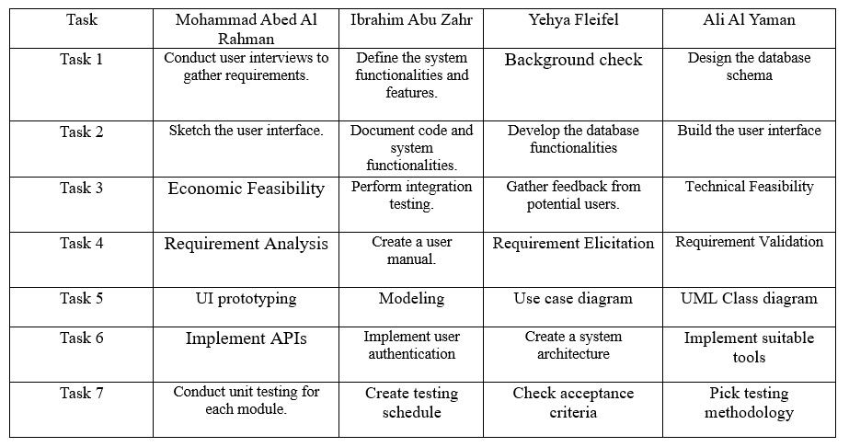
Task Organization

Slide 7
Project Organization
During our research for exploring the best software development environment , we came along interesting paths for ClickUp , Trello, Microsoft – To Do and Jira.
- Why Trello?
It offers a user-friendly interface, flexible structure, collaboration features, integration options, and mobile accessibility.
Why Jira?
It supports agile methodologies like Scrum and Kanban, offers customizable workflows, and integrates with popular tools.

Slide 8
Project Organization (2)
Why Microsoft To Do?
It features a simple, intuitive interface, task organization features, collaboration, and offline access.
Why ClickUp?
It features a simple, intuitive interface, task organization features, collaboration, and offline access.
Overall, each platform offers unique benefits, from ClickUp's comprehensive task management capabilities to Jira's advanced support for agile methodologies.
Hence, Jira software has been selected due to its efficient organization of teamwork, robust analytics capabilities, effective sprint planning and backlog management.

Slide 9
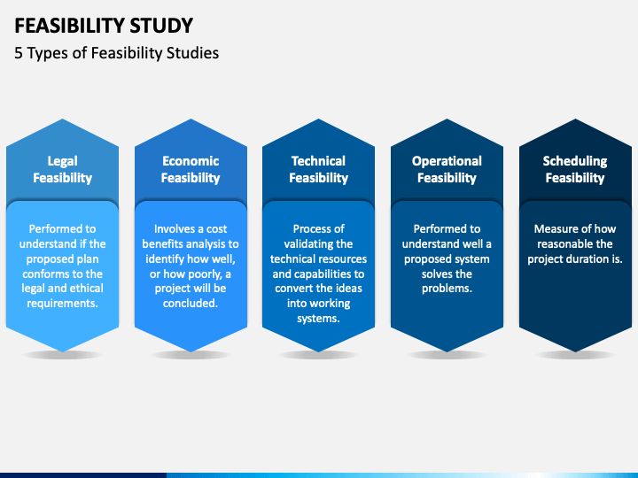
Feasibility Study
Is our software Legally Feasible?
Yes, it is legally doable.
Is our software Technically Feasible?
Yes, it uses modern age tech without complicating things especially in Lebanon.
Is our software Economically Feasible?
Lets check the numbers!

Slide 10
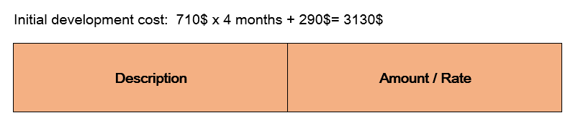
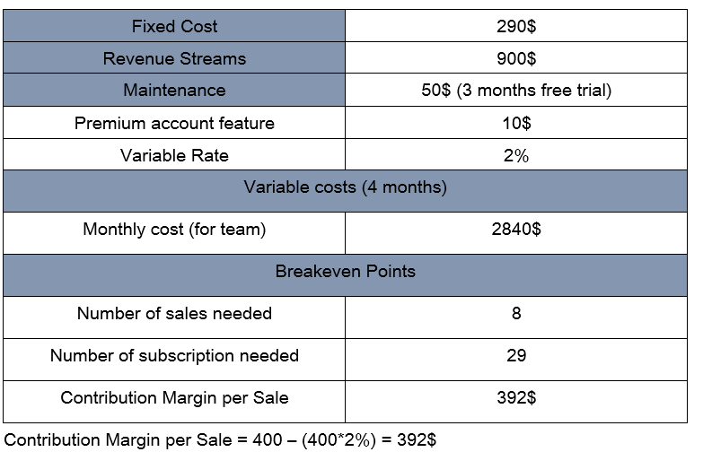
Break Even Analysis
The adjacent table shows the Fixed costs, Variable costs and the Breakeven point in which when the software will start to become profitable.

Slide 11
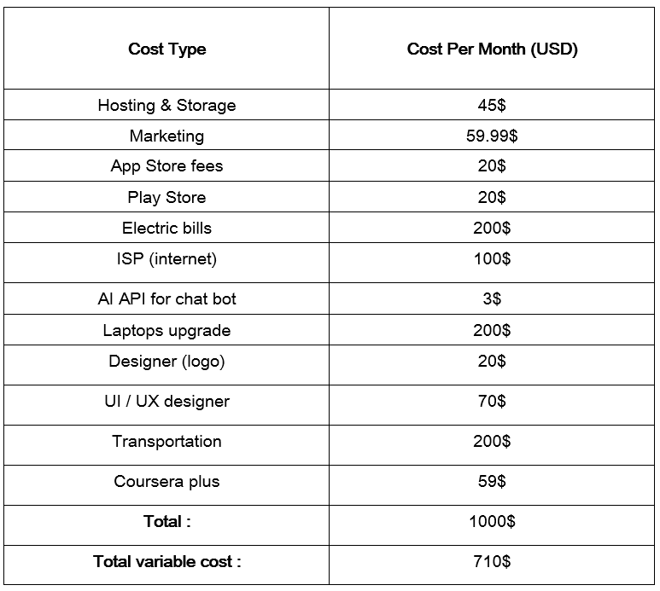
Overall Costs

Slide 12
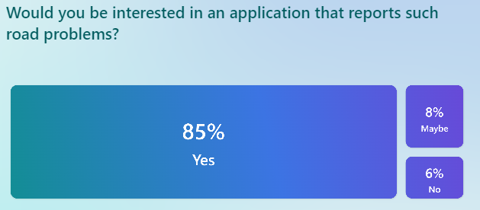
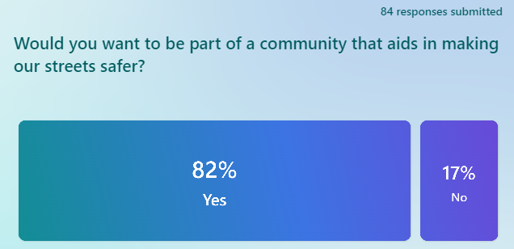

Survey(84 responses)
Above statistics also indicate that our project is also market feasible!

Slide 13
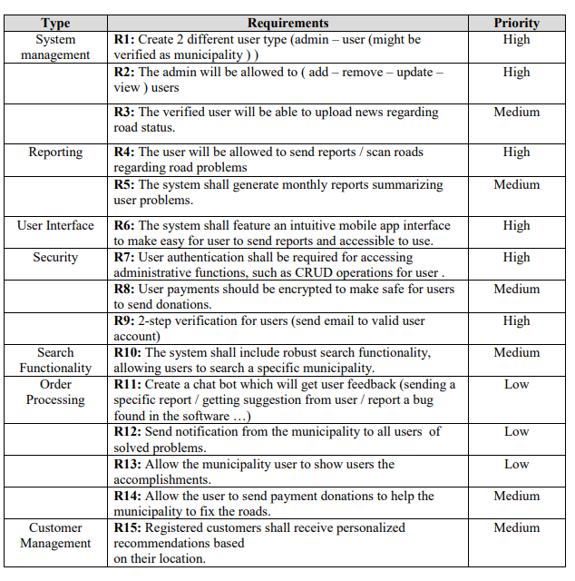
Requirements(Non-Functional and Functional)

Slide 14
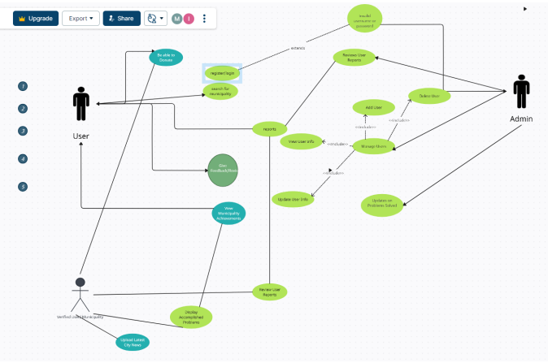
Use case diagram
Link : https://app.creately.com/d/DI0ZsIYsijt/edit

Slide 15
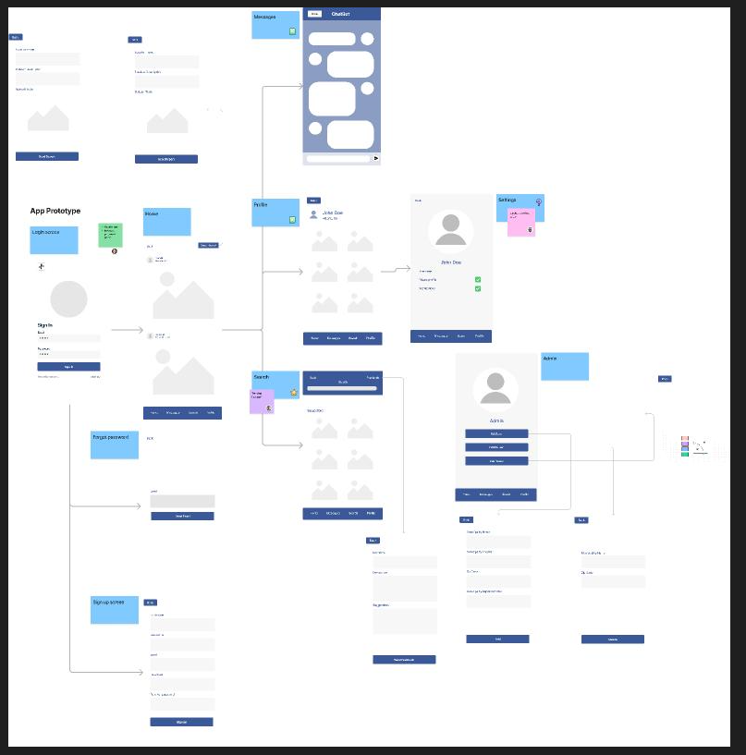
Design Scheme
https://www.figma.com/file/pEabKvfTPbD6dpeAzgNWua/Untitled?type=whiteboard&node-id=0-1

Slide 16
Thank you!
Looking forward to see you support our project!

